Slide 1

Library management system

Slide 2
What is library management system?
A Library Management System, also known as automated library management system is software that has been developed the basic housekeeping functions of a library. Library automation is the general term for information and communications technologies(ICT) that are used to replace manual systems in the library.
The Library Management System is a data processing to perform routine Library activities. This system is concerned with developing a library management system using database software.

Slide 3
Goals of the project
To reduce paperwork
High performance
Retrieve information in minimum time
More user friendly
Reduce work overload
Highly secure
Light weight

Slide 4
About python
The Python language type is a high-level, dynamically typed one that is among the most popular general-purpose programming languages. It is among the world’s fastest-growing programming languages and is used by software engineers, Python is an Interpreted, object-oriented, and high-level programming language.mathematicians, data analysts, scientists, network engineers, students, and accountants.

Slide 5
About tkinter
Tkinter is a Python wrapper for Tcl/Tk providing a cross-platform GUI toolkit. On Windows, it comes bundled with Python; on other operating systems, it can be installed. The set of available widgets is smaller than in some other toolkits, but since Tkinter widgets are extensible, many of the missing compound widgets can be created using the extensibility, such as combo box and scrolling pane. IDLE, Python's Integrated Development and Learning Environment, is written using Tkinter and is often distributed with Python.

Slide 6
About mysql
MySQL is an open-source relational database management system (RDBMS). Its name is a combination of "My", the name of co-founder Michael Wideness’s daughter My, and "SQL", the abbreviation for Structured Query Language. A relational database organizes data into one or more data tables in which data may be related to each other; these relations help structure the data

Slide 7
Features OF Library management system
Adding details of the book
Deleting book details
Viewing all the books
Issuing book to students
Returning book

Slide 8
Prerequisites:
mysql connector for python
Tkinter
Pillow
pymysql
Database name:
db
Tables names:
Books
Issued_books

Slide 9
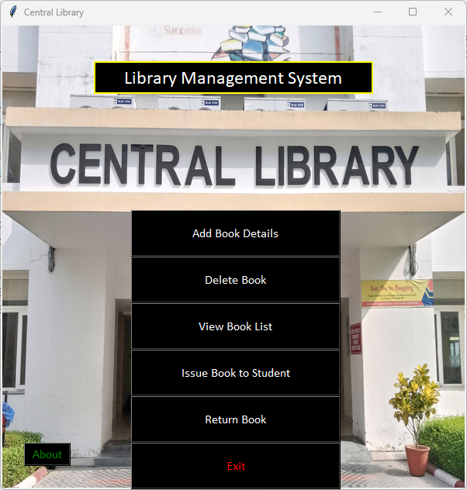
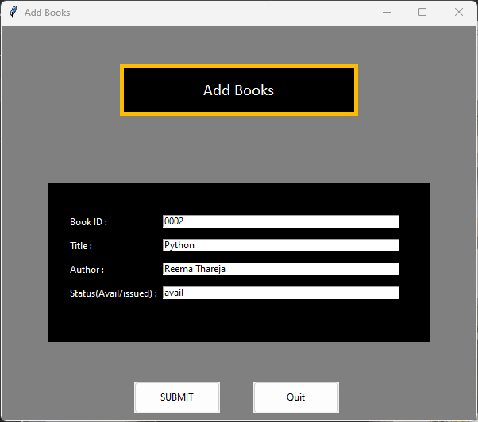
Snapshots:

Slide 10
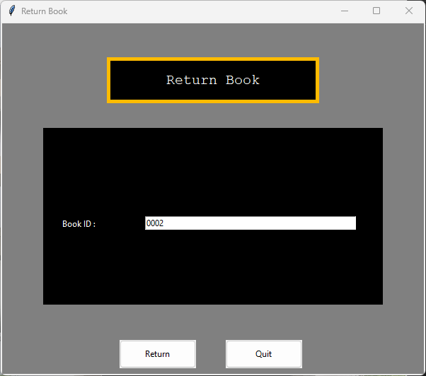
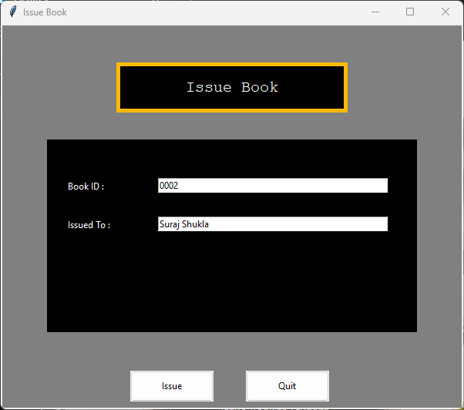

Slide 11
